Slide 1
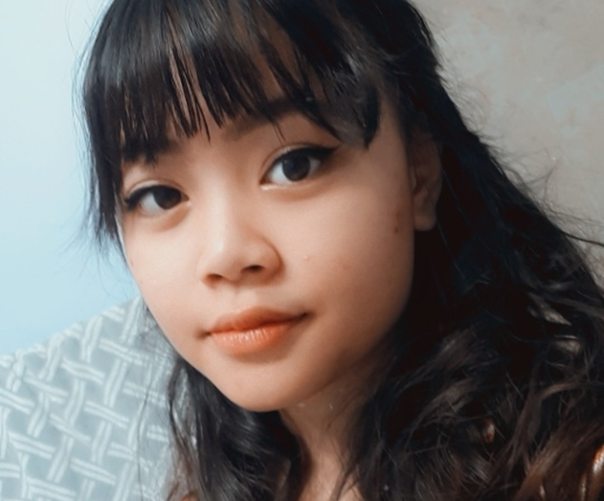
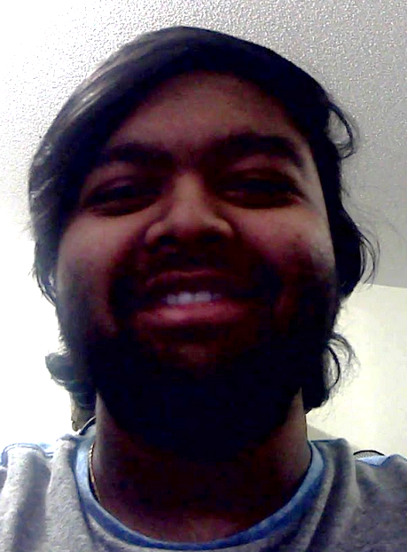
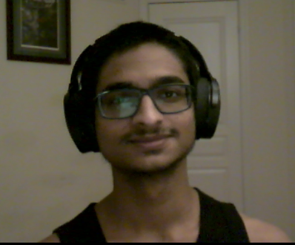
ASSIGNMENT 2
Kimberly Hansuwan 100752265 Seshawn Suresh 100752981 Mrinank Sivakumar 100748771
Intermediate Computer Graphics
INFR 2350 – U
Tom Tsiliopoulos

